Slide 1
Women and HIV
14th November 2022
Faculty
Pedro Cahn, Buenos-Aires, Argentina
Anton Pozniak, London, UK
François Raffi, Nantes, France
Guest Editor: Cristina Mussini, Modena, Italy

Slide 2
VIDEO
Please leave this box empty to display the video during the webinar
This presentation is made in complete editorial freedom
Thanks to ViiV Healthcare for their institutional support

Slide 3
Faculty Disclosures
Pedro Cahn has received research support for research grants: ViiV Healthcare, Merck, CanSino and for ad boards: ViiV Healthcare – Merck- Gilead
Cristina Mussini has received research support and/or honoraria for consulting and/or advisory boards from Angelini, Gilead Sciences, Janssen, MSD, Roche, Theratechnologies, ViiV Healthcare
Anton Pozniak has received research support and/or honoraria for consulting and/or advisory boards from ViiV Healthcare, Merck, Gilead, Janssen, Theratechnologies
François Raffi has received research support and/or honoraria for consulting and/or advisory boards from Gilead Sciences, Janssen, MSD, Theratechnologies and ViiV Healthcare

Slide 4
EPIDEMIOLOGICAL DATA
FR

Slide 5
Are women different from men ?
FR

Slide 6
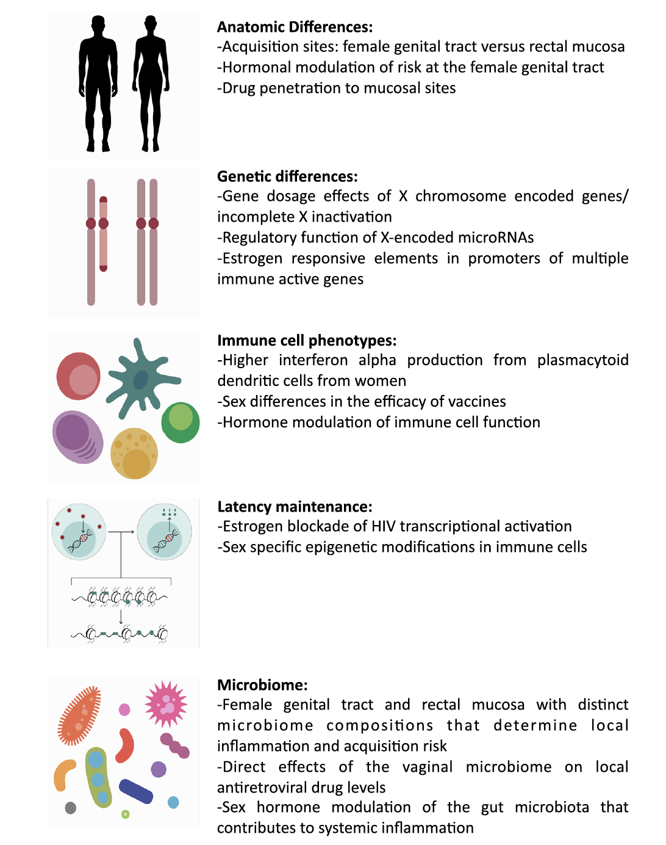
Are women different from men ?
CM
Yes….in so many ways
From the HIV perspective
Acquisition
Pathogenesis
Reservoir
Latency
Response to ART ?
ART-associated toxicity ?
Sex Differences in HIV infection. Sculley EP. Current HIV/AIDS Reports 2018; 15:136-46

Slide 7
Women with HIV
PC
20,2 M
53%
Women and girls
Living with HIV
of Total Population
Living with HIV
79%
1⁰
of WOMEN LIVING WITH HIV
received ART (2021)
Leading cause of death globally
for women aged 15 to 49
https://www.unaids.org/en/resources/fact-sheet

Slide 8
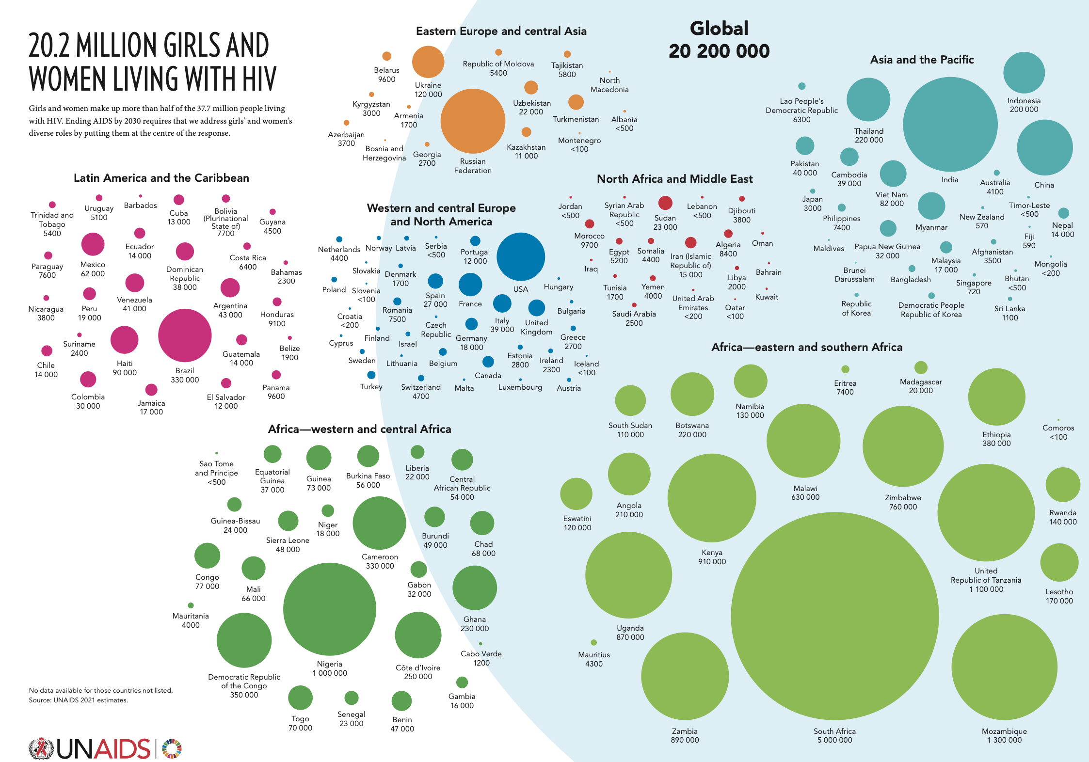
PC

Slide 9
Young women, 15-24 years are highly exposed
AP
Young women, aged 15-24 years
Make up 12% of the global HIV population
Make up 59% of new infections among their age group
In sub-saharan Africa, teenage girls and young women are 3 times as likely to acquire HIV as boys and young men
Every week, 5000 of them become infected with HIV (1 every 2 minutes)
Worsening situation during COVID
Millions of girls out of school
Spikes in teenage pregnancies and gender-based violence
Disruption to key HIV treatment and prevention services
UNAIDS March 2022 : Ending AIDS by 2030 requires that we address
girls’ and women’s diverse roles by putting them at the centre of the response.

Slide 10
AIDS = 1° cause of death in 15-49-year old females
AP
AIDS-related illnesses are the leading cause of death among 15-49-year-old females globally (hundred thousands)
21X
HIV INCIDENCE IS 21 TIMES HIGHER AMONG FEMALE SEX WORKERS THAN AMONG
THE GENERAL POPULATION
AROUND
44
adolescent girls (10-19 years) died of AIDS-related illnesses every day in 2018.
HIV
302,7
Maternal conditions
298,2
Ischaemic heart disease
182,3
Self-harm
164,1
Road injury
154,5
Tuberculosis
152,4
Stroke
143,4
Breast cancer
140,9
Cirrhosis of the liver
89,2
Diarrhoeal diseases
87,1
Source: Global health estimates 2016: deaths by cause, age, sex, by country and by region. 2000-2016 Geneva, World Health Organization; 2018.
Source: UNAIDS, 2019
Source: UNAIDS, 2019 estimates

Slide 11
Vulnerability of women in low-income countries
CM
7 out of 10 women in conflict setting and in refugee populations are exposed to gender-based and sexual violence.
Women who have experienced violence are 50% more likely to be living with HIV.
Women who have been physically or sexually abused by their partners report higher rates of mental health issues, including depression and anxiety, higher use of alcohol and less control over sexual decision-making.
www.unwomen.org/en/what-we-do/humanitarian-action/facts-and-figures
Jewkes, R. et al (2010). Intimate partner violence, relationship power inequity, and incidence of HIV infection in young women in South Africa: a cohort study. The Lancet 210; 376(9734):41-48

Slide 12
PMTCT
CM
In 2020, globally, 85% of pregnant women living with HIV had access to ARV to prevent transmission of HIV to their child
Great disparities by LIC regions
95% in East and Southern Africa
56% in West and Central Africa
30% in Middle East and North Africa
74% in Latin America
60% in Asia and the Pacific

Slide 13
Are Western European countries doing better ? PMTCT –UK 2014-2019
AP
Pregnancies among WOMEN LIVING WITH HIV
Data from the NHS integrated Screening Outcomes Surveillance Service
 | 2014-2015 | 2018-2019
N pregancies in WLHIV | ≠ 1,100 | 800-900
Maternal age > 40 years | 12.5% | 19.1%
Sub-Saharan Africa born | 72% | 64%
Eastern Europe born | 4% | 7%
UK born | 16% | 19%
Vertically-acquired HIV | 1.7% | 3.7%
Maternal diagnosis before pregnancy | 86.8% | 90.6%
On ART at conception - All women - Women HIV diagnosed | 67.2% 77.8% | 81.0% 89.6%
Antenatal CD4 count > 500/mm³ | 51.2% | 58.5%
Delivery viral load < 50 c/mL | 91.3% | 93.1%
Peters H. HIV Glasgow 2022, Abs. M046

Slide 14
HIV Vertical Transmission : UK 2000-2019
AP
Vertical transmission rate (%)
3.0%
2.86%
2.5%
2.0%
Reported vertical transmissions
Late diagnosis in many children
> 90% mothers born outside the UK
Half mothers diagnosed post-pregnancy
Adherence, social and/or psychological issues identified in the majority of mothers
1.65%
1.5%
1.24%
1.0%
0.80%
0.71%
0.48%
0.37%
0.5%
0.29%
0.27%
0.25%
0.0%
2000-01
2002-03
2004-05
2006-07
2008-09
2010-11
2012-13
2014-15
2016-17
2018-19
Year of infant's birth
Peters H. HIV Glasgow 2022, Abs. M046

Slide 15
FR
HIV-1 Perinatal Transmission Rates Among Women on ART at Conception
According to Time Period and Plasma Viral Load at Delivery
 | 2000-2005 N=1314 Transmission Rate |  | 2006-2010 N =1967 Transmission Rate |  | 2011-2017 N = 3035 Transmission Rate |  |  | All Time Periods N=6316 Transmission Rate
Plasma Viral Load Near Delivery (copies/mL) | % (95% CI) | n/N | % (95% CI) | n/N | % (95% CI) | n/N | P | % (95% CI) | n/N
<50 or < limit of quantification | 0.00 (.00-.40) | (0/921) | 0.00 (.0-.21) | (0/1750) | 0.00 (.00-.13) | (0/2811) | NS | 0.00 (.00-.07) | (0/5482)
50-399 | 0.00 (.00-2.25) | (0/162) | 0.59 (.01-3.25) | (1/169) | 0.00 (.00-2.11) | (0/173) | NS | 0.20 (.01-1.10) | (1/504)
>400 | 2.60 (.96-5.57) | (6/231) | 2.08 (.05-11.1) | (1/48) | 1.96 (.05-10.4) | (1/51) | NS | 2.42 (1.05-4.72) | (8/330)
Clin Infect Dis 2022 Aug 29;ciac703. doi: 10.1093/cid/ciac703. Online ahead of print.

Slide 16
HIV TESTING AND TREATMENT CASCADE, WOMEN (AGED 15+ YEARS) COMPARED TO MEN (AGED 15+ YEARS), GLOBAL, 2020
FR
WOMEN
MEN
20
18
18
Gap to reaching the first 90:
390 000
16
Gap to
reaching
the first 90:
1.4 million
16
Gap to
reaching
the first and
second 90s:
370 000
14
Gap to
reaching
the first and second 90s:
2.2 million
14
Gap to reaching the three 90s:
240 000
12
Gap to
reaching
the three 90s:
1.9 million
12
10
Number of women (million)
10
Number of men (million)
8
8
6
88%
[71—>98%]
79%
[61—95%]
72%
[58—86%]
6
4
4
82%
[65—>98%]
68%
[54—82%]
62%
[49—75%]
2
2
0
Women living with HIV who know their status
Women living with HIV who are on treatment
Women living with HIV who are virally suppressed
0
Men living with HIV who know their status
Men living with HIV who are on treatment
Men living with HIV who are virally suppressed
UNAIDS, special analysis 2021

Slide 17
COCOVIH : Proportion of untreated Persons living with HIV in 2019 - FRANCE
FR
By gender
By age
%
N=54,873
%
N=3,482
N=157,337
N=102,464
N=47,606
N=4,083
N=87,902
N=14,264
Men
Women
Overall
[18-25[ years
[25-45[ years
[45-65[ years
[65-75[ years
≥ 75
years
Prevoteau du Clary F. HIV Glasgow 2022, Abs. O33

Slide 18
COCOVIH : Overall mortality and impact of comorbidities and gender in Patients Living with HIV in France
FR
French observational study. SNDS = anonymized claim and hospitalization database of whole French population
Comparison of mortality of Persons Living with HIV included between 2006 and 2019 and of age-and gender-matched non HIV control group
Excess mortality in PERSONS LIVING WITH HIV : impact of Comorbidities according to gender
3.5 -
Men
3.5 -
Women
2.97
2.6 -
HR
2.625 -
1.96
2.06
HR
1.8 -
1.48
1.75 -
1.73
1.73
1.73
1.73
1.73
1.73
1.74
1.74
1.75
1.78
1.32
1.26
1.25
1.24
1.24
1.24
1.24
1.24
1.27
0.9 -
0.875 -
Adjustment on infectious diseases leads to a 49.6% decrease
Adjustment on infectious diseases leads to a 46.1% decrease
0.0 -
GG
AA/AG
0.0 -
GG
AA/AG
Hepatitis B
Stroke
Cancer
Hepatitis C
Hepatitis B
Stroke
Cancer
Unadjusted
Hepatitis C
Kidney disease
Unadjusted
Kidney diseases
Infectious diseases
Infectious diseases
Obstetric diseases
Psychiatric disorders
Psychiatric disorders
Ischemic cardiopathy
Ischemic heart diseases
Thrombo-mebolic events
Thrombo-mebolic events
Peripheral artery diseases
Peripheral artery disease
Prevoteau du Clary F. HIV Glasgow 2022, Abs. O33

Slide 19
Excess HR mortality in HIV Women than in Men compared to gender and age-matched general population
CM
Already described in previous studies (Spain, UK, Canada, Japan)
Higher and earlier prevalence of comorbidities
Linkage to care less than in men
Socio-economic status
Migration-associated problems
Stigma isolation
Impact on HIV Cascade
WAVE EACS Initiative

Slide 20
PREVENTION IN WOMEN
CM

Slide 21
AP
Baeten JM.
Phase 3, double-blind, placebo-controlled
Dapivirine 25 mg ring/month
2629 women
0,12 -
Phase 3B, double-blind, placebo-controlled
Dapivirine 25 mg ring/month
1342 women
AT M12: HIV incidence reduced by 39% vs expected rate
Placebo
Dapivirine
0,08 -
0,04 -
Reduction of 27% in HIV incidence
(efficacy correlated with adherence)
0,00 -
I
0
I
5
I
10
I
15
I
20
I
25
I
30
Baeten JM. Lancet HIV 2021; 8:e87-95

Slide 22
HPTN 084 Study: updated results of CAB LA IM Q 2 months versus TDF/FTC PO for PrEP
PC
HIV incidence
Randomized clinical trial in women
Superiority of CAB LA vs TDF/FTC in the blinded phase (HR 0.12)
Unblinded follow-up period Nov 2020-Nov 2021
3 additional breakthrough infections in CAB group associated with poor/absent product use
%
Combined blinded and unblinded period, through Dec 2021
HR = 0.11 ; 95% CI = 0.05-0.24
3,5
3,0
56 infections 3292 person years
1.70
2,5
2,0
1,5
6 infections 3334 person years
0.18
1,0
0,5
0,0
CAB N=1613
TDF/FTC N=1610
Delany-Moretiwe S, AIDS 2022, Abs. OALBX0108

Slide 23
Feasibility of Long-Acting Combination HIV and Pregnancy Prevention Implant in Mouse Model
PC
90-day in vivo study in BALB/c female mice
4 injectable ISFIs: DTG (278 mg/kg) + medroxyprogesterone acetate (70 mg/kg), DTG (278 mg/kg) + etonogestrel (70 mg/kg), CAB (1215 mg/kg) + medroxyprogesterone acetate (76 mg/kg), CAB (1215 mg/kg) + etonogestrel (151 mg/kg), and control (no implant)
12 mice/group for PK studies + 12 mice/group for safety analyses
Results
SC, biodegradable, and removable long-acting ARV + contraceptive implant is feasible in humanized mouse model
Implant sustained release of ARV above concentration needed to inhibit viral replication for 90-day trial period
No difference in ARV release when coformulated with either contraceptive drug
Implant generally well tolerated
Young I, CROI 2022, Abs. 80

Slide 24
VACCINE IN WOMEN
CM

Slide 25
Imbokodo: Phase IIb Trial of Heterologous HIV-1 Vaccine Regimen Among Women in Sub-Saharan Africa at High Risk for HIV Infection
CM
Multicenter, randomized, double-blind, placebo-controlled phase IIb trial
Cumulative incidence of HIV infections (%)
0.10
Incidence (rate/100 PY (95 % CI)
M24 Primary analysis
Placebo: 4.3 (3.3 ; 5.5)
0 .08
Vaccine: 3.6 (2.7 ; 4.8)
Healthy, HIV-1/2–negative women at high risk for HIV infection; sexual intercourse ≥ 2 times in 30 days prior to screening
(N = 2637)
Vaccine*
(N = 1314)
0.06
0.04
Placebo
(N = 1323)
0.02
0
*Vaccine regimen consisted of 2 doses of Ad26.Mos4.HIV (1 dose at Mo 0 and 3) followed by 2 doses of Ad26.Mos4.HIV + adjuvanted clade C gp140 (1 dose at Mo 6 and 12)
0
3
7
9
12
15
18
21
24
Months
N at risk
1 109
1 079
1 109
1 079
1 100
1 065
1 092
1 054
1 068
1 036
1 049
1 014
1 031
993
1 007
977
161
156
Cumulative number of HIV infections
0
0
0
0
0
0
3
6
18
17
28
27
42
34
51
40
63
51
Vaccine efficacy, primary endpoint (from M7 to M24 in PP population): 25.2 % (95 % CI : -10.5 to 49.4) ; p = 0.14
Gray GE, CROI 2022, Abs. 121

Slide 26
MANAGEMENT of HIV INFECTION in WOMEN
CM

Slide 27
Gender differences in the treatment of HIV infection
CM
No gender differences in immunological, virological and clinical course of HIV infection
In general, no gender differences in response to ART
In some studies, female subjects appear to be more susceptible to adverse events related to ART
Pharmacokinetics for some ARVs may differ between men and women, with higher exposure in women, related to body weight and composition, renal clearance, and P-glycoprotein activity
However, less relevant with modern ARVs
Factors potentially involved in determining sex differences in pharmacologic effects
Body weight and composition, blood and organ volumes (e.g. bone mass) Absorption, intestinal motility and secretions Transport and distribution Protein binding and tissue affinity Metabolism: phase I (hydrolysis, reduction, oxidation, cyclization, decyclization) Metabolism: phase II (conjugation) Excretion (glomerular filtration rate, renal clearance) Intracellular metabolism Activity of drug transporters Differential (hormone-mediated) gene expression Effect modifiers: Adherence Diet and nutritional factors Nutritional status Concomitant treatments Hormonal environment Reproductive status Smoking
Marco Floridia*, Marina Giuliano, Lucia Palmisano, Stefano Vella, Pharmacological Research 2008; 58:173-82

Slide 28
Women often face more social problems than men
CM
Social determinants
Economic Stability | Neighborhood and Physical Environment | Education | Food | Community and Social Context | Health Care System
Employment Income Expenses Debt Medical bills Support | Housing Transportation Safety Parks Playgrounds Walkability | Literacy Language Early childhood education Vocational training Higher education | Hunger Access to healthy options | Social integration Support systems Community engagement Discrimination | Health coverage Provider availability Provider linguistic and cultural competency Quality of care
Health Outcomes Mortality, Morbidity, Life Expectancy, Health Care Expenditures, Health Status, Functional Limitations
Copyright 2018 American Medical Association - Downloaded From: https://edhub.ama-assn.org/

Slide 29
Management of women with HIV
CM
U = U
Contraception counselling
Cancer and pre-cancerous lesions screening
Vaccines
Pre-pregnancy counselling
Menopause
Sexual dysfunctions
Isolation, economic instability
Difficulties in accessing health care
Stigmatisation
Partner violence enquirement

Slide 30
Cancer screening - - EACS Guidelines V 11.1 - Oct 2022
CM
Assessment | Frequency | Population
Mammography | Every 1-3 years | Women 50-74 years
Cervical PAP or liquid based cytology (+ HPV genotype testing) | Every 1-3 years | Women > 21 years
Anal exam ± anal cytology/anoscopy | Every 1-3 years | Women with HPV-associated dysplasia (cervix, vaginal, vulval)

Slide 31
ART in WOMEN GENERAL CONSIDERATIONS - GUIDELINES
FR

Slide 32
Selecting ART for women
FR
Women with child-bearing potential : Always think about unplanned pregnancy
Older women : increased co-morbidities risk : cardiovascular, bone, decreased kidney function, mental health
For all women : drug interactions
Contraceptives and Hormone Replacement Therapy
Antidepressants, anxiolytics
Lipid-lowering and hypoglycemic agents
Calcium supplementation

Slide 33
ART in Women of Childbearing Age : Points to Consider
FR
Safety Considerations
Pregnant women excluded from ART clinical trials
Efficacy Considerations
Some ARVs have lower serum concentrations, particularly in second and third trimester, with risk of loss of viral suppression
Experience of ART in pregnancy gathered when women become pregnant intentionally or unintentionally
Pregnancy often not recognized until during or after greatest risk of teratogenic effects (6 first weeks)
DDIs between certain ARVs and some hormonal contraceptive methods may reduce contraceptive efficacy or increase risk of adverse events
Notes:
DDI, drug–drug interaction.

Slide 34
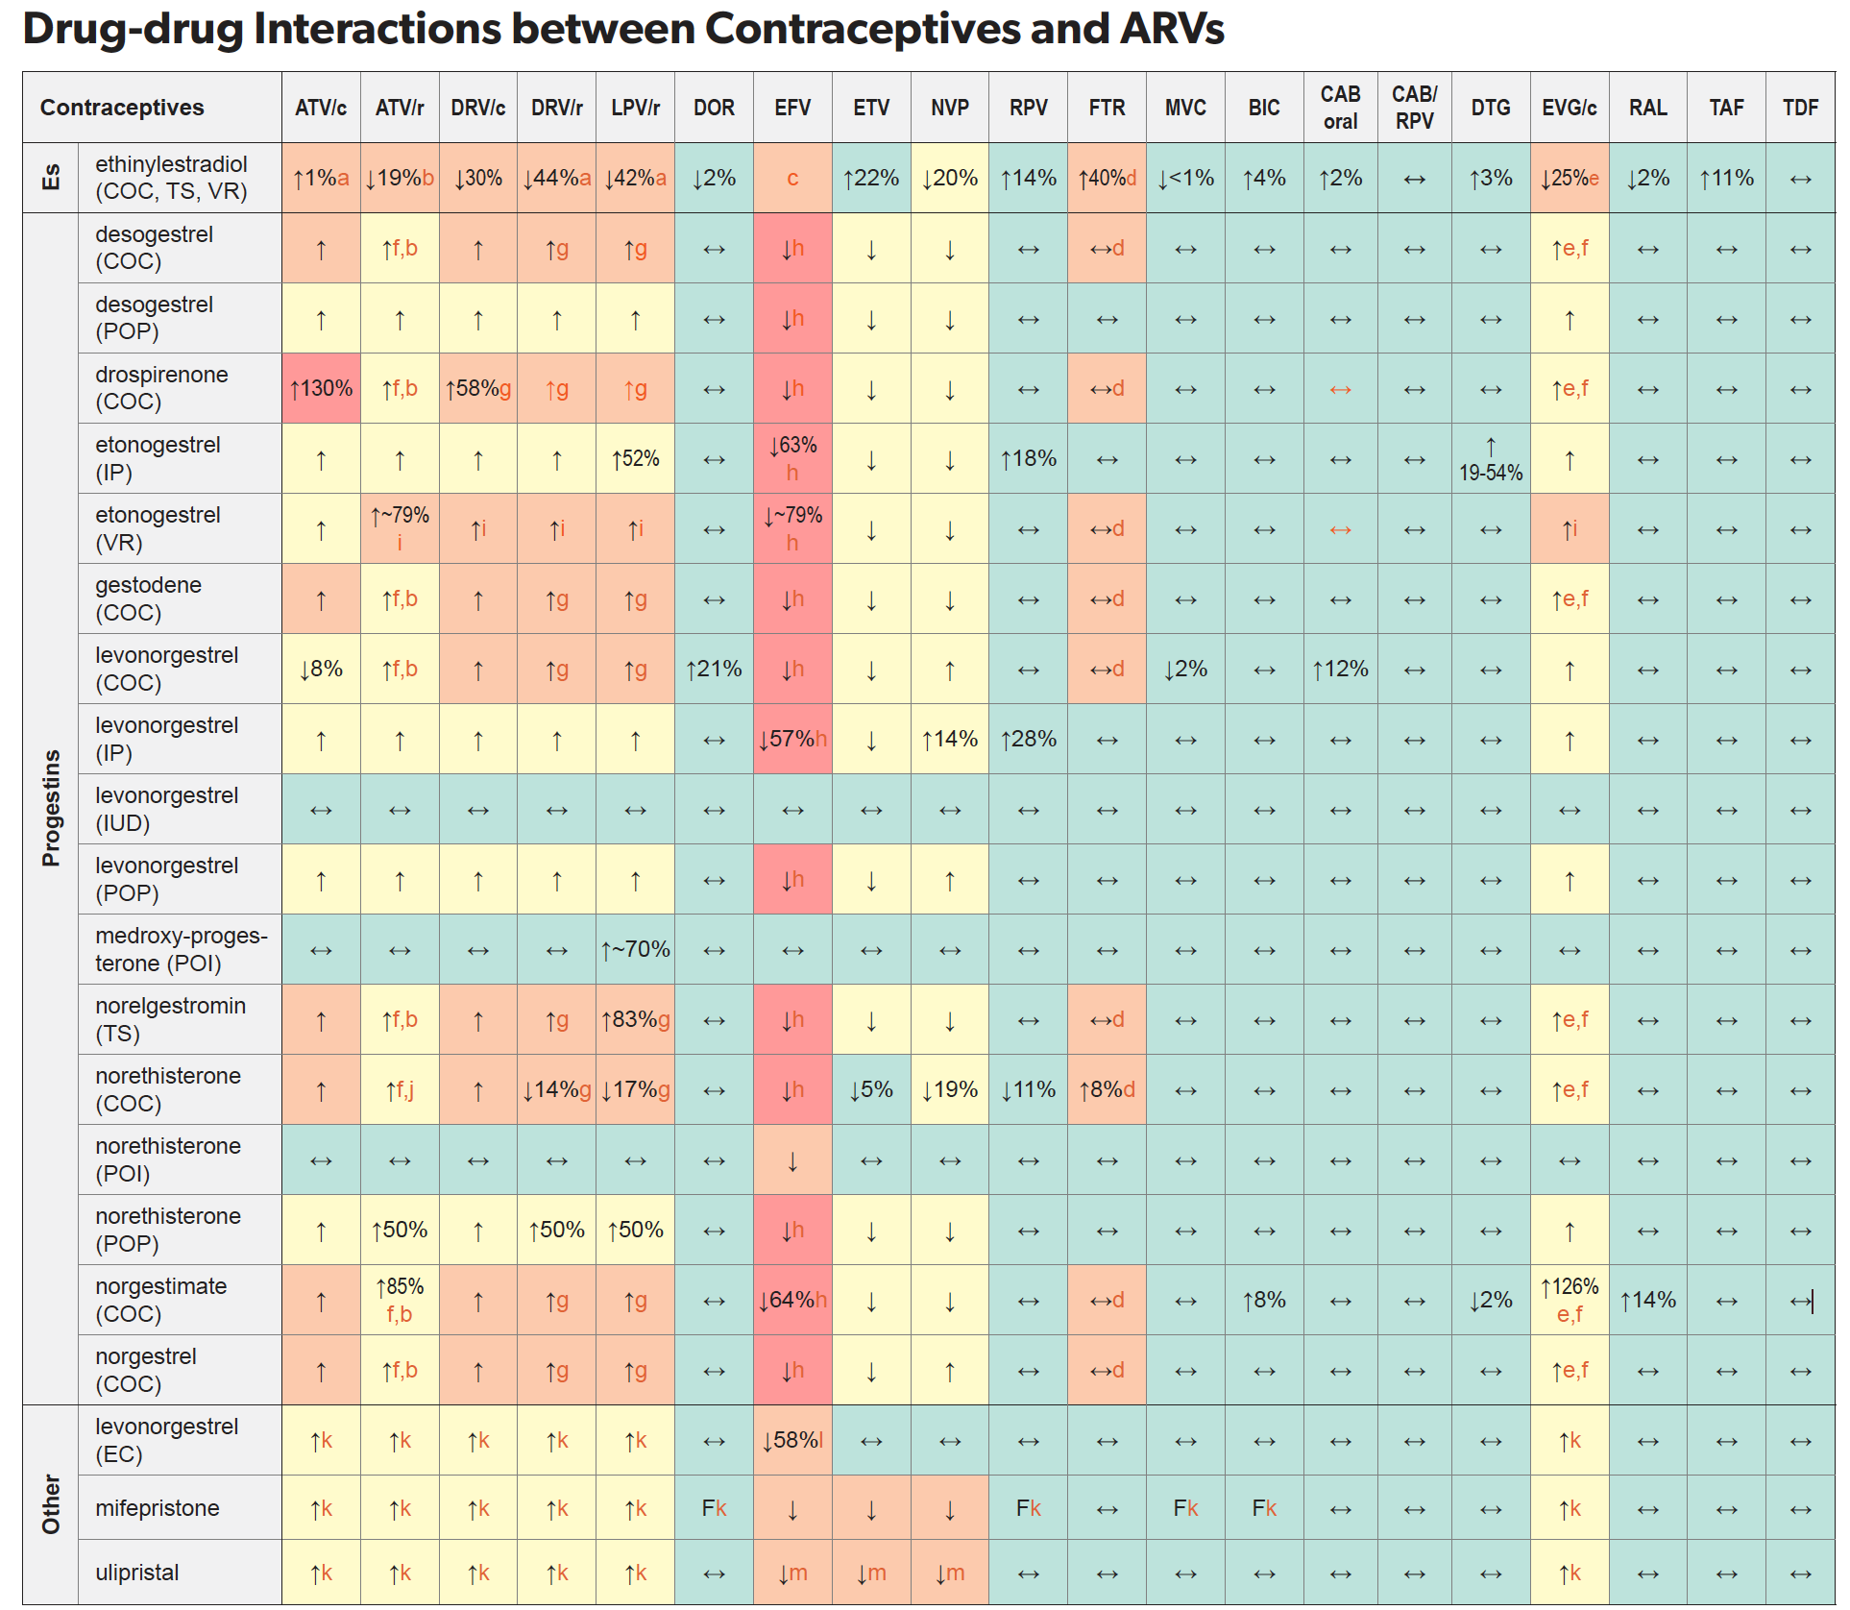
FR
EACS Guidelines Oct 2022

Slide 35
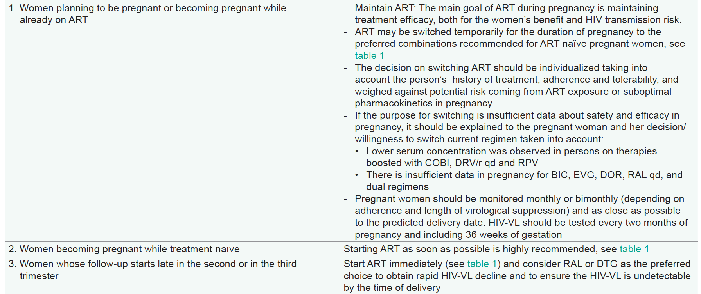
ART in pregnant women or women considering pregnancy - EACS Guidelines V 11.1 - Oct 2022
FR

Slide 36
Key Considerations in Women Trying to Conceive
FR
For women trying to conceive, choice or modification of ART should aim for sustained viral suppression prior to conception
Goals of ART are efficacy and tolerability focusing on
Woman’s benefit and maternal health
Prevention of perinatal HIV transmission (virologic suppression throughout pregnancy and especially at delivery)
Prevention of sexual transmission to partner
Do not restrict choice of ART regimen in women of childbearing age
Change with caution fully suppressive ART regimen in women who become pregnant : provide medical guidance in a noncoercive manner, respect woman’s autonomy in decision-making

Slide 37
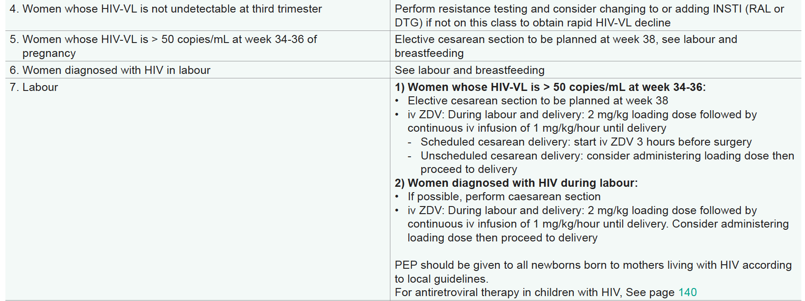
3rd trimester and Labour EACS Guidelines V 11.1 - Oct 2022
FR

Slide 38
ARIA: DTG/ABC/3TC vs ATV + RTV + FTC/TDF in Treatment-Naive Women
PC
Multinational, randomized, open-label phase IIIb trial, 13 countries, 4 continents
499 ART-naïve women : DTG/ABC/3TC vs ATV/r + TDF/FTC
Mean age : 38 y, Black : 42%, IVDU : 4%
Adverse events
HIV-1 RNA < 50 c/ml at W48 (ITT, snapshot)
 | DTG group (N=248) | ATV group (N=247)
Drug-related AEs (occuring in > 5 % of participants in either group) Nausea Diarrhoea Dyspepsie Ocular icterus Headache Jaundice | 83 (33%) 31 (13%) 12 (5%) 4 (2%) 0 5 (2%) 0 | 121 (49%) 35 (14%) 18 (7%) 15 (6%) 18 (7%) 14 (6%) 13 (5%)
Psychiatric AEs (occuring in > 2 % of participants in either group) Insomnia Anxiety Depression Suicidal ideation Depressed mood | 35 (14%) 10 (4%) 5 (2%) 5 (2%) 4 (2%) 3 (1%) | 35 (14%) 9 (4%) 7 (3%) 7 (3%) 3 (1%) 4 (2%)
Serious adverse events | 12 (5%) | 20 (8%)
Drug-related serious adverse events | 0 | 3 (1%)
100 -
86
Dolutegravir group (ITT-E, n = 248)
Atazanavir group (ITT-E, n = 247)
Dolutegravir group (PP, n = 230)
Atazanavir group (PP, n = 225)
82
80 -
76
71
60 -
40 -
20 -
14
12
15
13
6
6
11
8
0 -
Virological success
Virological non-response
No virological data
DTG: non-inferior and superior to ATV/r
Orrell. Lancet HIV. 2017;4:e536-46.

Slide 39
IMPAACT 2010 Study : DTG vs EFV & TDF vs TAF during pregnancy
AP
Phase III, randomised, open-label study, HIV+ pregnant women, ARV naïve
HIV RNA < 200 c/mL at delivery
Pooled DTG vs EFV/FTC/TDF
Risk difference
6.5 % (2.0 -10.7)
Risk difference:
6.0 % (1.6 -10.3)
DTG + FTC/TAF pregnancy and post-partum
p = 0.005
p = 0.008
N = 213
%
100
97.5
97.5
R
DTG + FTC/TDF pregnancy and post-partum
91
91.4
N = 213
80
EFV/FTC/TDF pregnancy and post-partum
N = 213
60
Inclusion at
14-28 weeks
of pregnancy
40
Delivery
W50
post-partum
20
0
Combined DTG arms
EFV/FTC/TDF
Combined DTG arms
EFV/FTC/TDF
Primary endpoint: HIV RNA < 200 c/mL at delivery
ITT
Per protocol
Chinula L, CROI 2020, Abs. 130LB

Slide 40
IMPAACT 2010 Study : Maternal Virologic Outcomes
AP
Maternal HIV-1 RNA Suppression at week 50 postpartum
Maternal Virologic Failure
2 successive HIV RNA≥200 copies/mL at or after 24 weeks on study
100%
p = 0.97
15%
96.3%
96.4%
80%
p = 0.012
p = 0.63
p = 0.040
10%
10.4%
60%
40%
5%
5.1%
20%
4.1%
0%
0%
Combined DTG arms
EFV/FTC/TDF
DTG+FTC/TAF
DTG+FTC/TDF
EFV/FTC/TDF
Per ITT analysis
Post hoc statistical comparisons
Chinula. CROI 2021. Abs. 177

Slide 41
IMPAACT 2010 Study : Adverse events
AP
Maternal and Infant Grade 3 or Higher Adverse
Events by Arm Through 50 Weeks Postpartum
40%
p = 0.26
p = 0.11
4 infants with major congenital abnormalities
2 in DTG + FTC/TAF arm
2 in EFV/FTC/TDF arm
p = 0.098
p = 0.26
p = 0.25
p = 0.32
30%
30.8%
30.9%
27.9%
28.6%
25.1%
25.3%
% women/infants with AE
20%
p < 0.001
10%
p = 0.20
p = 0.08
6.9%
7.0%
8.5%
1.0%
2.0%
4.6%
0%
Maternal Grade > 3 AE
Infant Grade > 3 AE
Infant Deaths
Stillbirth Infant Deaths*
DTG+FTC/TAF
DTG+FTC/TDF
EFV/FTC/TDF
*Post hoc analysis
Chinula. CROI 2021. Abs. 177

Slide 42
IMPAACT 2010 Study : Neonatal survival
AP
1.00
+
+
+
+
+
DTG + FTC/TAF group
DTG + FTC/TDF group
EFV/FTC/TDF group
0.95
+
Estimated probability of neonatal survival
Log-rank p values
DTG, FTC, and TAF group vs DTG, FTC, and TDF group p = 0.65
DTG, FTC, and TDF group vs EFV, FTC, and TDF group p=0.050
DTG, FTC, and TAF group vs EFV, FTC, and TDF group p=0.019
0.90
0
4
8
12
16
20
24
28
Time since birth (days)
Lockman S. Lancet. 2021;397:1276-92

Slide 43
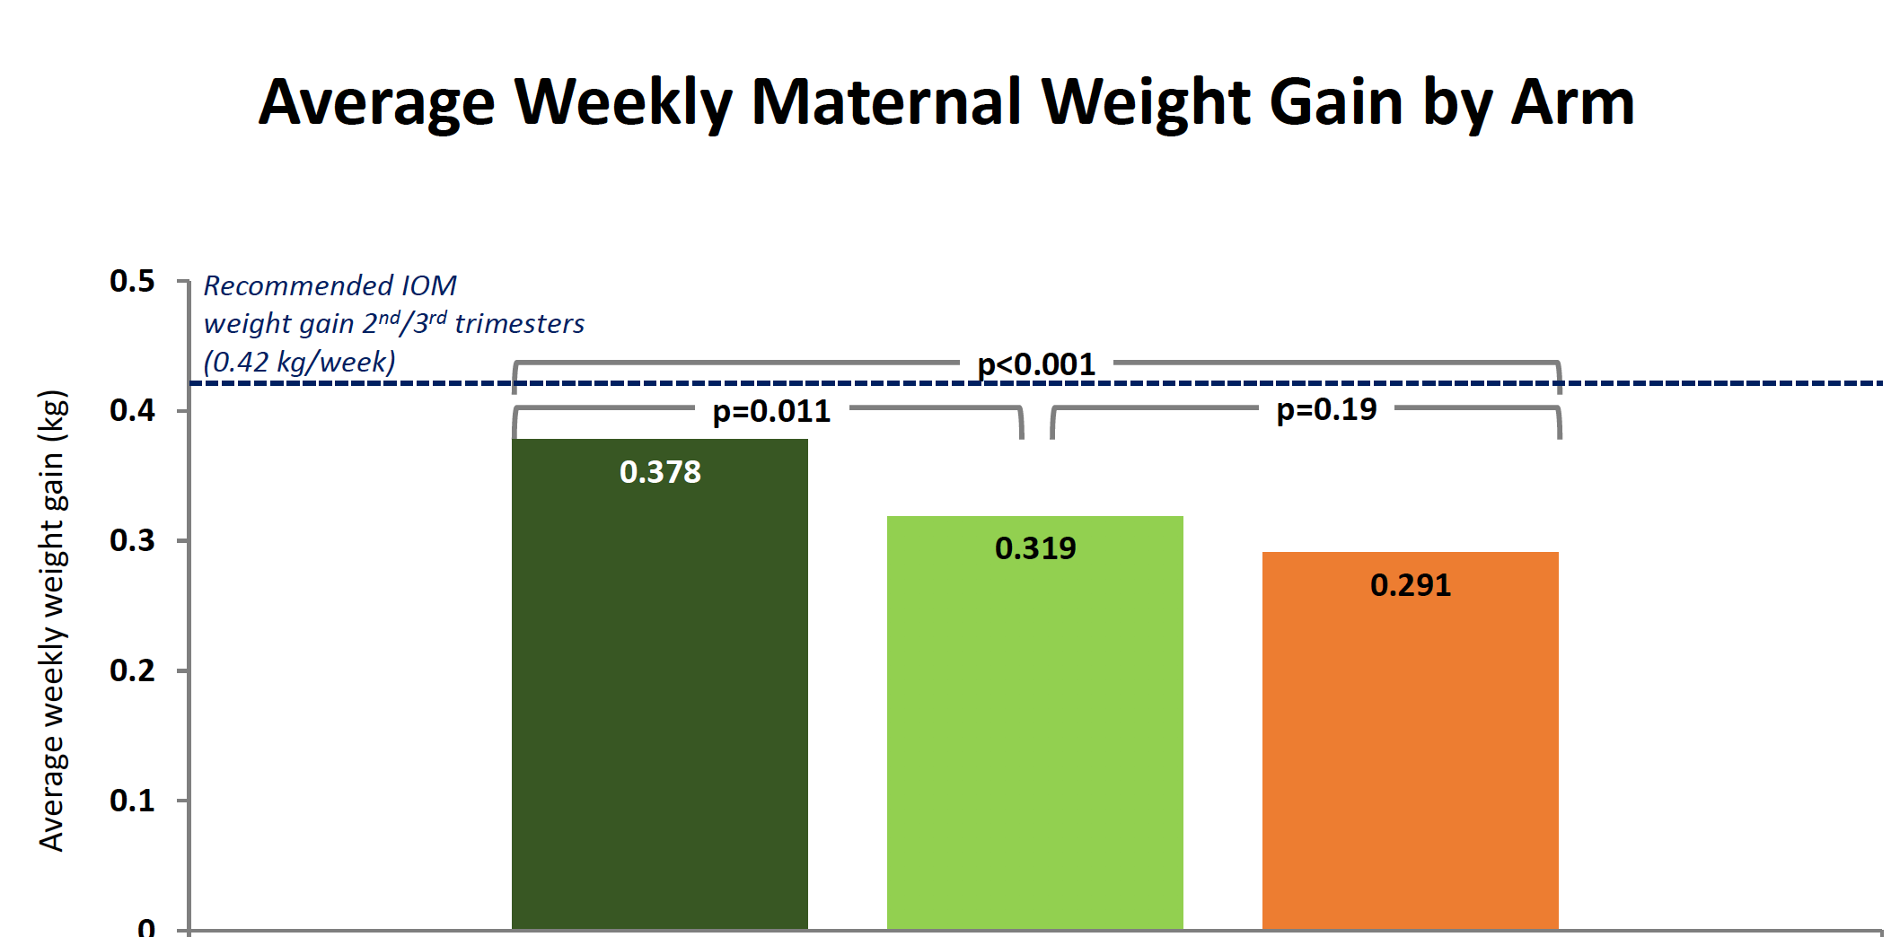
0.378
0.319
0.291
DTG+FTC/TAF
DTG+FTC/TDF
EFV/FTC/TDF

Slide 44
IMPAACT 2010 Study : Maternal Weight
AP
Average Weekly Maternal Weight Change Enrollment through Week 50 Postpartum
0.000
-0.027
Conclusions
DTG > EFV
Significantly less adverse events with DTG + FTC/TAF
Significantly less stillbirths with DTG than EFV
Weight loss significantly lower with DTG + FTC/TAF (more obesity in this group at W50 post-partum)
-0.050
-0.050
-0.084
p < 0.001
-0.100
p = 0.041
p = 0.002
DTG+FTC/TAF
DTG+FTC/TDF
EFV/FTC/TDF
Chinula. CROI 2021. Abs. 177

Slide 45
Breastfeeding
CM
This topic should be discussed as early as possible in pregnancy
We advise against breastfeeding, as in high-income settings the optimal way to prevent MTCT is to feed infants born to mothers living with HIV with formula milk
If a woman chooses to breastfeed, we recommend input from an interdisciplinary team including adult HIV specialist, paediatrician and obstetrician/gynecologist
Monthly follow-up during the whole breastfeeding period with increased clinical and virological monitoring of both the mother and the infant.
Measurement of drug concentrations in the milk could be done to inform clinical practice
Maternal HIV-VL > 50 copies/mL should result in cessation of breastfeeding, providing cabergoline and support from interdisciplinary team and a nursing specialist
Currently there is no evidence supporting PrEP for the infants who are breastfed
After stopping the breastfeeding, the child should undergo routine diagnostics as recommended in HIV-exposed children

Slide 46
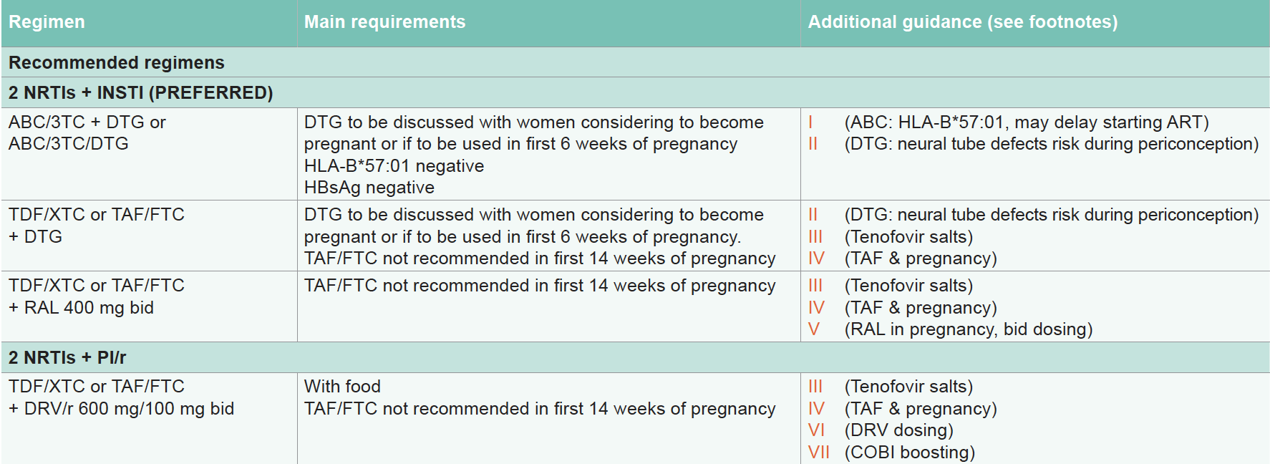
ARV regimen for ART-naive pregnant women EACS 2022
PC
II A minimal non-significant increase in neural tube defects was shown among women receiving DTG from conception compared with all other antiretroviral exposure

Slide 47
PC
ARV recommended during pregnancy
ATV/r AIIa
DRV/r AIIa
DTG AIb
EFV BIa
RAL AIIa
RPV BIIa
JAMA. 2020 Oct 27;324(16):1651-1669

Slide 48
DHHS : ART Recommendations During Pregnancy and When Trying to Conceive: NRTIs and INSTIs
PC
2 NRTIs + 1 INSTI | Pregnant, ART Naive | Become Pregnant on Suppressive, Well-Tolerated ART
ABC/3TC | Preferred | Continue
TDF or TAF / 3TC or FTC | Preferred | Continue
ZDV | Alternative | Continue
DTG | Preferred * | Continue *
RAL | Preferred | Continue
BIC | Insufficient data | Insufficient data
CAB | Not recommended | Insufficient data
EVG/COBI | Not recommended | Not recommended
* Use of DTG at conception/very early pregnancy has been associated with small but statistically significant increase in the risk of NTDs; this information should be discussed with patients to ensure informed decision-making
DHHS Perinatal Guidelines. March 2022

Slide 49
DHHS : ART Recommendations During Pregnancy and When Trying to Conceive: NNRTIs and PIs
PC
2 NRTIs + 1 NNRTI or 1 PI/b | Pregnant, ART Naive | Become Pregnant on Suppressive, Well-Tolerated ART
EFV | Alternative | Continue
RPV | Alternative | Continue*
ETR | Not recommended | Continue
NVP | Not recommended | Continue
DOR | Insufficient data | Insufficient data
ATV/RTV | Preferred | Continue
DRV/RTV | Preferred ** | Continue **
LPV/RTV | Not recommended except in special circumstances | Continue
ATV/COBI | Not recommended | Not recommended
DRV/COBI | Not recommended | Not recommended
* Only if pretreatment HIV-1 RNA ≤100,000 copies/mL and CD4+ cell count ≥200 cells/mm³
** Dosed twice daily in pregnancy
DHHS Perinatal Guidelines. March 2022

Slide 50
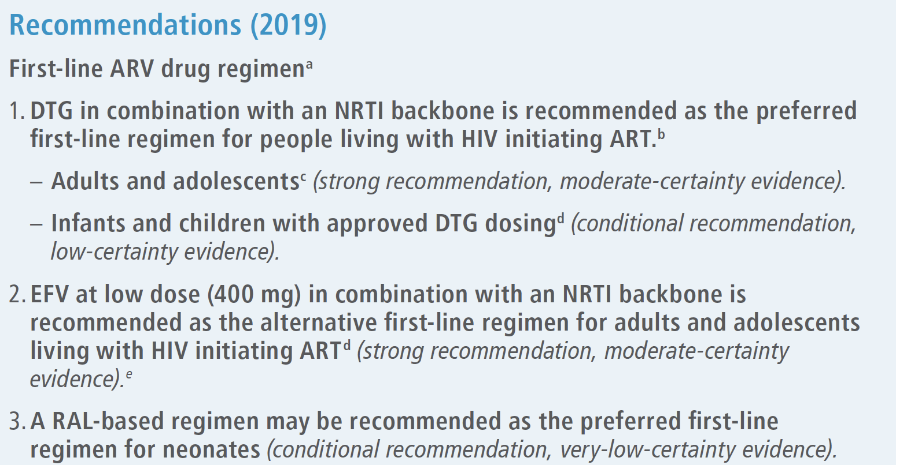
WHO ART Guidelines 2021
PC

Slide 51
RISK of INSTI DURING CONCEPTION ?
FR

Slide 52
Neural Tube defects incidence following ARV exposure at conception
FR
Tsepamo birth outcomes surveillance study in Botswana : in May 2018, unplanned analysis found increase in NTD incidence among women who conceived on DTG¹
DTG vs non-DTG ART: 0.94% (95% CI: 0.37-2.4) vs 0.12% (95% CI: 0.07-0.21)
Prevalence difference: 0.82% (95% CI: 0.24-2.3)
Most recent analysis reports data from Tsepamo through March 2022²
With additional DTG conception exposures, prevalence of NTDs among infants has declined to a much lower level, that does not substantially differ from other exposure groups.
1. Zash. NEJM. 2018; 379:979. 2. Zash. AIDS 2022. AIDS 2020. Abs. PELBB02
Notes:
ART, antiretroviral therapy; DTG, dolutegravir; NTD, neural tube defect.

Slide 53
Tsepamo March 20222 Update: Prevalence of NTDs by ARV Exposure
FR
Parameter | Conception |  |  | Pregnancy | HIV Negative (n = 170,723)
 | DTG (n = 9,460) | Non-DTG (n = 23,664) | EFV (n = 14,432) | DTG (n = 6,551)
Total NTDs per exposures, n/N | 10 | 25 | 11 | 4 | 108
NTD prevalence, % (95% CI) | 0.11 (0.06-0.19) | 0.11 (0.07-0.16) | 0.08 (0.04-0.14) | 0.06 (0.02-0.16) | 0.07 (0.05-0.08)
Prevalence difference for DTG at conception, March 2022, % (95% CI) | Ref | 0.00 (-0.07 to 0.10) | 0.03 (-0.05 to 0.12) | 0.04 (-0.06 to 0.14) | 0.04 (-0.01 to 0.13)
Zash. AIDS 2022. Abs. PELBB02
Notes:
ARV, antiretroviral; DTG, dolutegravir; EFV, efavirenz; NTD, neural tube defect.

Slide 54
Antiretroviral Pregnancy Registry: Birth Defects After DTG Exposure
AP
Prevalence of Drug-Specific Birth Defect Rates²
Birth Defects by Timing of DTG Exposure, n (%) | Number per Live Births, n/N | Prevalence, % (95% CI)
Overall | 39/956 | 4.1 (2.92-5.53)
First trimester | 19/576 | 3.3 (2.00-5.10)
Periconception | 16†/475 | 3.4 (1.94-5.41)
Later first trimester | 3/101 | 3.0 (0.62-8.44)
Second/third trimester | 20/380 | 5.3 (3.24-8.01)
Defects/Live Births
MACDP
TBDR
Lamivudine
169/5433
TDF
108/4483
Zidovudine
136/4225
Emtricitabine
104/3952
Ritonavir
81/3453
Atazanavir
33/1447
Lopinavir
30/1439
Abacavir
43/1368
Nelfinavir
47/1212
Nevirapine
35/1171
Efavirenz
28/1166
Stavudine
21/811
Darunavir
24/643
Dolutegravir
19/576
Rilpivirine
8/557
Birth defect prevalence in any trimester with prenatal DTG consistent with
General population¹
Prevalence in MACDP: 2.72 (95% CI: 2.68-2.76)
Prevalence in TBDR: 4.17 (4.15-4.19)
Any prenatal ARV exposure: 2.85 (95% CI: 2.63-3.09)
TAF
22/526
Raltegravir
15/486
Cobicistat
17/473
Didanosine
20/427
Elvitegravir
11/371
Indinavir
7/289
Telbivudine
3/254
First Trimester APR
310/10950
Any Trimester APR
590/20686
MACDP
TBDR
0
1
2
3
4
5
6
7
8
9
Prevalence (%)
1. Vannappagari. IDWeek 2021. Abstr 74. 2. apregistry.com/forms/interim_report.pdf
Notes:
APR, Antiretroviral Pregnancy Registry; ARV, antiretroviral; DTG, dolutegravir; MACDP, Metropolitan Atlanta Congenital Defects Program; NTD, neural tube defect; TAF, tenofovir alafenamide; TBDR, Texas Birth Defects Registry; TDF, tenofovir disoproxil fumarate.

Slide 55
Pregnancy Outcomes After RAL Exposure
AP
RAL manufacturer Adverse Event Review and Reporting System (MARRS): 961 prospective, 520 retrospective reports
No increased rate of spontaneous abortion, stillbirth, or congenital anomalies in pregnant women exposed to RAL vs background population
No NTDs in prospective reports of RAL exposure at conception/during first trimester a; 1 case of anencephaly following initiation of RAL during second trimester, considered unrelated to RAL exposure
440 periconception exposures to RAL (UK and France Cohorts) : no NTDs
Shamsuddin. IDWeek 2019. Abstr 886.
Notes:
NTD, neural tube defect; RAL, raltegravir.

Slide 56
Birth Outcomes with INSTI use during pregnancy
AP
Antiretroviral pregnancy registry data reported through July 2020¹
No increased risk of birth defects with first-line INSTIs above the expected rate of defects in the general population (2.72‐4.17/100 live births from MACDP and TBDR, respectively)^{1,2}
INSTI | Total Outcomes | Live Births | Cases with Birth defects | CNS Defects | NTDs | Encephalocele Defects
Any BIC exposure Periconception | 91 56 | 85 51 | 2 2 (3.92 %) | 1 1 | 0 0 | 0 0
Any DTG exposure Periconception | 915 479 | 842 420 | 33 13 (3.095 %) | 4 2 | 1 1 | 0 0
Any RAL exposure Periconception | 953 392 | 891 350 | 30 11 (3.14 %) | 1 0 | 0 0 | 0 0
1. http://www.apregistry.com/forms/interim_report.pdf. 2. Vannappagari. EACS 2019. PS1/2.
Notes:
BIC; bictegravir; CNS, central nervous system; DTG, dolutegravir; INSTI, integrase strand transfer inhibitor; MACDP, Metropolitan Atlanta Congenital Defects Program; NTD, neural tube defect; RAL, raltegravir; TBDR, Texas Birth Defects Registry.

Slide 57
Summary : ARV and pregnancy
CM
Risk of neural tube defects : with most recent data and large population exposure, DTG and non-DTG ART taken at time of conception have similar low risk of neural tube defects
In all guidelines, DTG is now among preferred regimen regardless of desire to conceive or pregnancy status
If ART is started during pregnancy, DTG achieves better maternal and infant outcomes as compared with EFV
In combination with DTG, TAF appears to be safe and potentially advantageous compared with TDF during pregnancy
No data on BIC/FTC/TAF to make any recommendation
Notes:
ART, antiretroviral therapy; DTG, dolutegravir; EFV, efavirenz; TAF, tenofovir alafenamide; TDF, tenofovir disoproxil fumarate.

Slide 58
NON-AIDS COMORBIDITES in WOMEN
CM

Slide 59
Non-AIDS Comorbidity burden in Women with HIV Women’s Interagency HIV Study
CM
WIHS : multicenter prospective US cohort established in 1993.
Women living with HIV and at-risk women without HIV enrolled during 4 waves (1994–1995, 2001–2002, 2011–2012, 2013–2015)
Baseline characteristics
 | HIV+ N =2239 | HIV- N = 890
Median age, years | 38 | 36
Median FU, years | 14.3 | 14.4
BMI ≥ 30 kg/m2 | 40% | 47%
Antihypertensive mediaction | 20% | 16%
Lipid-lowering medication | 5% | 5%
Current smoker | 44% | 54%
Current alcohol use | 48% | 57%
Current marijuana use | 20% | 29%
Current crack/cocaine use | 10% | 15%
Current opiod use | 3% | 5%
IVDU | 2% | 3%
Prevalence of each NACM increased successively by age group (<40, 40-49, 50-59, ≥60yrs) in the cohort overall and by HIV serostatus
Incidence rate of NACM higher among women HIV+ vs HIV- (all p < 0.01)
Rate per 1000 PYs | HIV+ | HIV-
Psychiatric illness | 50, 2 | 37.1
Bone disease | 39.3 | 28.7
Dyslipidemia | 36.7 | 27.3
Liver disease | 28.4 | 11.5
Chronic kidney disease | 11.9 | 4.7
NON-AIDS Cancer | 5.5 | 3.7
No significant difference by HIV serostatus : HTN, Diabetes, CVD, lung disease
Collins LF. Clin Infect Dis 2021; 73 (7):e2059-69

Slide 60
Non-AIDS Comorbidity burden in Women with HIV Women’s Interagency HIV Study
CM
Adjusted NACM incidence rate/PY by age group
Conclusions :
Women with HIV have higher prevalence and incidence of Non-AIDS Comorbidity burden than women without HIV
Differences in Non-AIDS Comorbidity burden by HIV serostatus begin in the 3rd decade of life
0,35 -
0,30 -
0,25 -
NACM incidence Rate/PY
0,20 -
HIV negative
HIV positive
0,15 -
0,10 -
0,05 -
I
<25
I
25-29
I
30-34
I
35-39
I
40-44
I
45-49
I
50-54
I
45-49
I
>55
Age category, years
Collins LF. Clin Infect Dis 2021; 73 (7):e2059-69

Slide 61
MACS/WIHS Combined Cohort Study
CM
Characteristics at end of observation
Non-AIDS Comorbidity prevalence (All patients)
 | Women, n = 3238 | Men, n = 2691
Median age, y | 51 | 58
Median BMI, Kg/m2 | 30 | 26
Black race | 65% | 25%
Low income | 78% | 32%
Ever smoking | 68% | 70%
 | Women with HIV n = 2316 | Men with HIV n = 1452
Median time on ART, y | 12.9 | 15.4
Median CD4/mm3 | 620 | 636
HIV RNA < 200 c/mL | 81% | 86%
 | Women | Men
Hypertension | 68% | 75%
Psychiatric illness | 55% | 58%
Dyslipidemia | 41% | 64%
Liver disease | 31% | 34%
Bone disease | 42% | 19%
Lung disease | 38% | 10%
Diabetes | 24% | 17%
Cardiovascular disease | 15% | 15%
Kidney disease | 14% | 15%
Cancer | 7% | 12%
Median number of NACM burden higher
in women than in men (3.4 vs 3.3, p = 0.015)
Collins LF. CROI 2021, Abs. 526

Slide 62
NON-AIDS Comorbidities in Women with HIV
CM
Cardiovascular disease
Risk x 2 vs Men : non-calcified plaques more common
Incidence of pulmonary arterial hypertension 40% higher
Mixed data on hypertension
Stroke risk x 2-3
Metabolic dysfunction
Mixed data on diabetes
More weight gain on ART
Acceleration of dysfunction post-menopause
Bone disease
BMD lower pre-ART
ART initiation exacerbates sex difference (more rapid loss on TDF)
Menopause further exacerbates risk
Neurocognitive impairment
Greater risk
Lower score on learning and memory, information processing speed, motor function
Frequently associated with psychiatric illness
Cervival (and anal cancer)

Slide 63
ADVANCE: Mean Change in Weight by Gender at Week 192
PC
Significantly greater weight increase with DTG vs EFV, with TAF vs TDF at W192
decrease in slope of weight gain after W48, more evident in men than in women
Weight change from baseline, Kg - FEMALES
Weight change from baseline, Kg - MALES
14
TAF/FTC + DTG
14
TAF/FTC + DTG
12
TDF/FTC + DTG
12
TDF/FTC + DTG
TDF/FTC/EFV
TDF/FTC/EFV
10
10
8
8
6
6
4
4
2
2
0
0
0
24
48
72
96
120
144
168
192
0
24
48
72
96
120
144
168
192
Time since enrolment (weeks)
Time since enrolment (weeks)
623
587
561
546
530
517
511
504
499
200
327
324
430
403
387
376
374
369
357
355
350
164
249
251
Of note : at baseline : Median BMI was 21.7 kg/m² in men and 25.9 kg/m² in women
Venter WDF, AIDS 2022, Abs. PELBB01

Slide 64
ADVANCE: Obesity and metabolic syndrome
PC
Predictors of incident obesity (BMI ≥ 30), Cox model
Treatment emergent metabolic syndrome
 | HR (95% CI) | p
Treatment group TDF/FTC/EFV TDF/FTC + DTG TAF/FTC + DTG | (Ref) 1.48 (0.91 – 2.41) 3.28 (2.10 – 5.14) | ns < 0.001
Age | 0.98 (0.96 – 1.00) | 0.057
Baseline BMI | 1.82 (1.68 – 1.98) | < 0.001
Female | 2.14 (1.38 – 3.32) | 0.001
Baseline log₁₀ HIV RNA | 1.97 (1.58 – 2.46) | < 0.001
 | TAF/FTC + DTG (N=351) | TDF/FTC + DTG (N=351) | TDF/FTC/EFV (N=351)
Women | 20% | 12% | 10%
Men | 7% | 6% | 3%
Venter WDF, AIDS 2022, Abs. PELBB01

Slide 65
MENOPAUSE in HIV WOMEN
PC

Slide 66
PC
Swiss HIV Cohort Study
PWHIV : 25% are women
Study of women being menopaused between January 2010 and Decembre 2018
Exclusion : TGW, menopause > 55 y, ovariectomy/hysterectomy
Menopause definition : No menstruations > 12 months. Early menopause if < 45 years
HIV Medicine 2022; 23:417-25

Slide 67
Menopause in HIV Women - SHCS
PC
Menopause prevalence – Swiss cohort
Demographic shift of women participating in the Swiss FIN Cohort Study (SHCS) between 2010 and 2018. (a) Proportion of postmenopausal women over time. (b) Age histogram of women participating in the SHCS in 2018
(a)
(b)
3000
2536
2588
2630
2663
2640
2663
200
2382
2437
2493
274
390
491
562
649
751
844
904
961
150
2000
100
Total women in follow-up
Total women in follow-up
1000
50
0
20
30
40
50
60
70
80
90
0
Years
2010
2011
2012
2013
2014
2015
2016
2017
2018
Year
Increase x 3 of menopaused women (36% in 2018)
In 2018 : 31% of women with HIV have 39-49 years : menopause within 10 years
Postmenopause
Pre/perimenopause
HIV Medicine 2022; 23:417-25

Slide 68
Early menopause in HIV women
PC
Comparison of demographic characteristics between women with early menopause and women with normal age of menopause onset
 | Women with menopause onset at age ≥ 45 years (n = 1015) | Women with early menopause onset (age < 45 years) (n = 115) = 10% | p (normal vs. early)
Ethnicity Other than black Black | 796 (78.4%) 219 (21.6%) | 55 (47.8%) 60 (52.2%) | < 0.001
BMI Normal weight Underweight (BMI < 18 kg/m²) Overweight (BMI > 25 kg/m²) | 516 (50.8%) 82 (8.1%) 417 (41.1%) | 60 (52.2%) 4 (3.5%) 51(44,3%) | 0.20
HIV and comorbidities CD4 count < 200 cells/gL Viral load < 50 copies/mL Hepatitis C (active or cleared) Hepatitis B (active or immunologically controlled) Depression or in psychiatric care | 51 (5.0%) 871 (85.8%) 339 (33.4%) 461 (45.4%) 273 (26.9%) | 7 (6.1%) 104 (90.4%) 24 (20.9%) 50 (43.5%) 27 (23.5%) | 0.62 0.073 0.006 0.76 0.43
Black ethnicity : risk x 4 of early menopause [aOR = 4.2, 95% CI : 2.5-7.2, p < 0.001]
HIV Medicine 2022; 23:417-25

Slide 69
Menopause in HIV Women - SHCS
PC
Healthcare provision and utilization during perimenopause
Health care provision and utilization | Ethnicity other than black (n = 851) | Black ethnicity (n = 279) | p-value
Gynaecological examination during the 6 months preceding menopause | 353 (42%) | 114 (41%) | 0.87
Gynaecological examination during the 36 months preceding menopause | 784 (92%) | 250 (90%) | 0.19
Received a BDM within 36 months after the last bleeding | 243 (29%) | 59 (21%) | 0.02
ART missed more than once a month | 57 (7%) | 20 (7%) | 0.78
On HRT during the 6 months preceding menopause documentationª | 98 (12%) | 27 (10%) | 0.38
HIV Medicine 2022; 23:417-25

Slide 70
AP
Women’s Interagency HIV Study
609 postmenopausal women (mean age : 51, 80% HIV+)
Relationship of ever hormone therapy use (oral, patch or vaginal) with
subclinical atherosclerosis : carotid artery intima-media thickness, distensibility, plaque
biomarkers of immune activation and D-dimer
Women who ever used HT (vs never-users) had
43% lower prevalence of plaque (prevalence ratio, 0.57 [95% CI 0.40–0.80]; p<0.01),
2.51 μm less progression of CIMT per year (95% CI, –4.60, to –0.41; p=0.02),
marginally lower incidence of plaque over approximately 7 years (risk ratio, 0.38 [95% CI, 0.14–1.03; p=0.06),
These findings were similar for women with and without HIV.
Ever HT use was associated with lower serum D-dimer, but not with biomarkers of immune activation after covariate adjustment.
Clin Infect Dis. 2022 Jul 29:ciac620

Slide 71
AP
Progression of carotid artery intima-media thickness (CIMT) over time in ever and never hormone therapy (HT) users
n = 233
n =80
Slope different from zero (p<0.0001)
Slope not different from zero (p= 0.11)
Conclusion : HT may confer a subclinical cardiovascular benefit in women with HIV
Peters BA. Clin Infect Dis. 2022 Jul 29:ciac620.

Slide 72
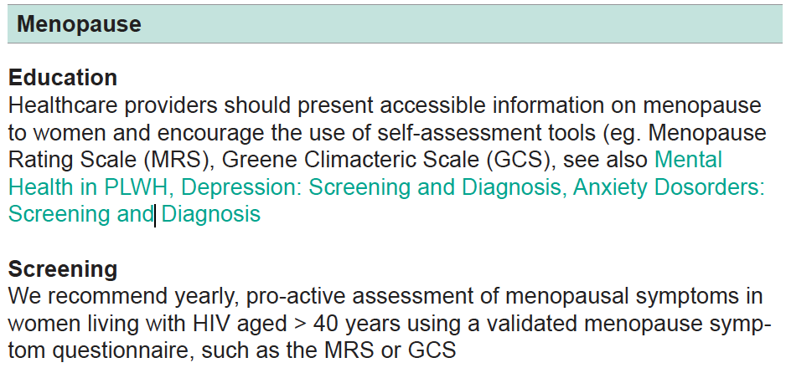
EACS Guidelines V 11.1 - Oct 2022
CM

Slide 73
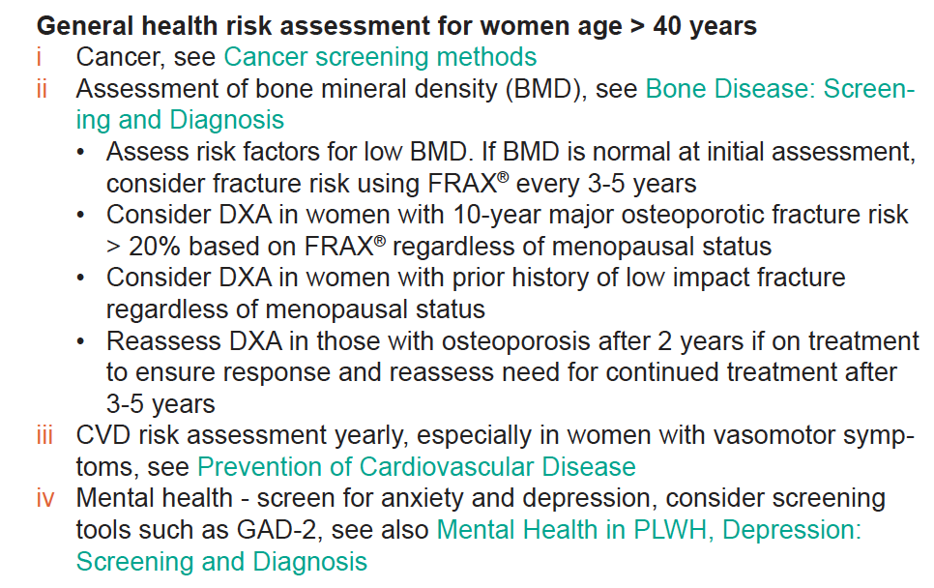
EACS Guidelines V 11.1 - Oct 2022
CM

Slide 74
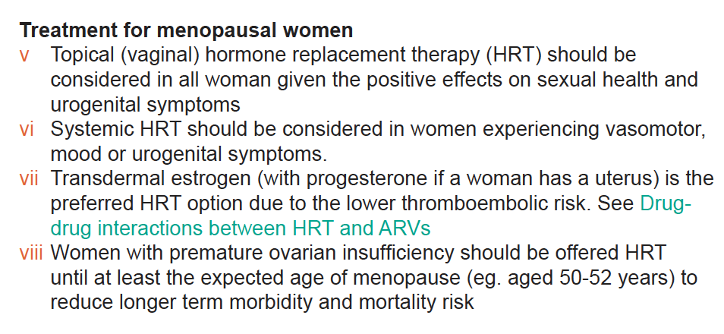
EACS Guidelines V 11.1 - Oct 2022
CM

Slide 75
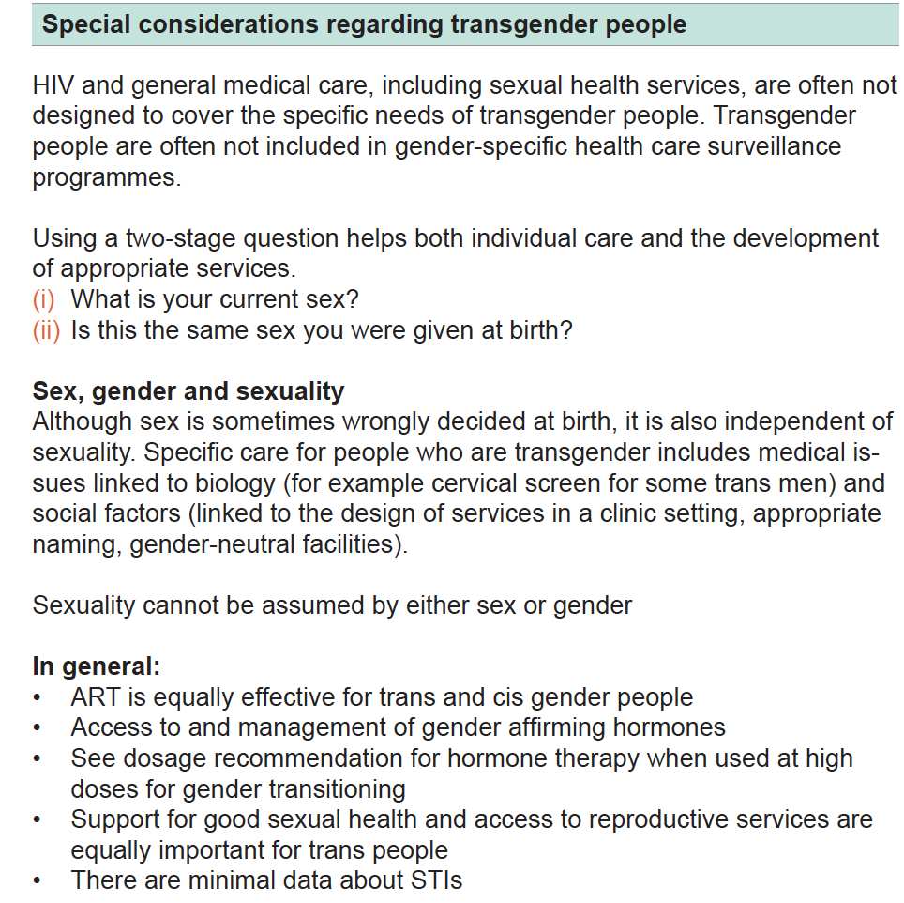
CM

Slide 76
Take home messages
CM
Women represent worldwide the most affected population and all efforts should be made to prevent HIV infection in women
Great progresses have been made concerning MTCT and the safety of antiretrovirals in pregnancy
Women are caregivers and this has an impact on adherence and treatment outcome and this should be taken into account when tailoring antiretroviral regimens in this population.
Particular attention should be taken in monitoring side effects, for example weight gain.
Many aspects of menopause should be investigated and monitored
Women should be included in clinical trials in proportion to their burden on the epidemic

Slide 77
Women and HIV
14 November2022
Faculty
Pedro Cahn, Buenos-Aires, Argentina
Anton Pozniak, London, UK
François Raffi, Nantes, France
Guest Editor: Cristina Mussini, Modena, Italy

Slide 78
VIDEO
Please leave this box empty to display the video during the webinar
present:
THEMATIC WEBINARS
Pedro CAHN Buenos-Aires, ARG
François RAFFI Nantes, FR
Anton POZNIAK London, UK
Does 2 equals 3? | September 20th
Women and HIV | November 14th
Simplifying HTE patients with complex ART regimens | December 13th
This webinar is proposed to you with the support of our institutional partner

